Slide 1
AS 1684 Residential timber-framed
construction
AS 1684 Residential timber-framed construction Part 1 to Part 4
supersedes
AS 1684-1992 Timber Framing Code

Slide 2
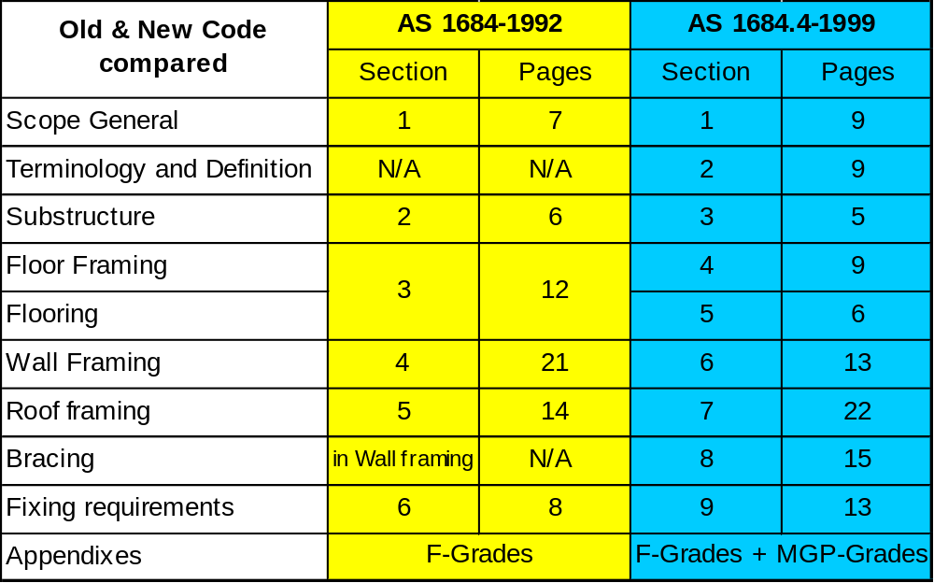
AS 1684 Residential timber-framed construction
Comparison of AS 1684-1992 with AS 1684-1999

Slide 3
AS 1684 Residential timber-framed construction
FLOOR BEARERS
TABLE 1 - Floor load width 1200 mm
TABLE 2 - Floor load width 2400 mm
TABLE 3 - Floor load width 3600 mm
TABLE 4 - Floor load width 4800 mm
TABLE 5 - Supporting floor load only
TABLE 6 FLOOR JOISTS
May support load-bearing walls perpendicular to joists
WALL STUDS - single or upper storey
TABLE 7 - Not notched
TABLE 8 - Notched 20mm
STUDS SUPPORTING CONCENTRATED LOADS
TABLE 9 - Not notched
TABLE 10 - Notched to 20mm
TABLE 11 JAMB STUDS - Single or upper storey
INTERNAL LOADBEARING WALL STUDS single or upper storey
TABLE 12 Not notched
TABLE 13 Notched to 20mm

Slide 4
AS 1684 Residential timber-framed construction
PLATES
TABLE 14 BOTTOM PLATES - Supporting single or upper storey
TABLE 15 TOP PLATES - Sheet roof - Single or upper storey
TABLE 16 TOP PLATES - Tile roof - Single or upper storey
LINTELS
TABLE 17 - Sheet roof - single or upper storey loadbearing walls
TABLE 18 - Tile roof - single or upper storey loadbearing walls
TABLE 19 - Sheet roof - supporting concentrated roof loads
TABLE 20 -Tile roof - supporting concentrated roof loads
CEILING JOISTS
TABLE 21 - Supporting ceiling loads (no overbatten)
TABLE 22 - Supporting ceiling loads (with overbatten)
BEAMS
TABLE 23 HANGING BEAMS - Supporting ceiling loads
TABLE 24 COUNTER BEAMS
TABLE 25 STRUTTING / HANGING BEAMS, Supporting roof & ceiling loads
TABLE 26 STRUTTING / COUNTER BEAMS, Supporting roof & ceiling loads
TABLE 27 STRUTTING BEAMS
TABLE 28 UNDERPURLINS
TABLE 29 RAFTERS OR PURLINS

Slide 5
AS 1684 Residential timber-framed construction
RIDGE OR INTERMEDIATE BEAMS
TABLE 30 - Single span
TABLE 31 - Continuous span
TABLE 32 - ROOF BATTENS - Supporting roofing only
FLOOR BEARERS Supporting two storey loadbearing walls
TABLE 33 - lower floor load width 1800 mm
TABLE 34 - lower floor load width 3600 mm
TABLE 35 - Lower storey of two storey, Supporting upper and lower floor loads only
WALL STUDS
TABLE 36 - Not notched lower storey loadbearing walls
TABLE 37 - Notched to 20 mm lower storey loadbearing walls
TABLE 38 - Not notched Supporting concentrated floor loads
TABLE 39 - Notched to 20mm Supporting concentrated floor loads
JAMB STUDS Lower storey of two storey
TABLE 40 - upper floor load width 1800 mm
TABLE 41 - upper floor load width 3600 mm
TABLE 42 - upper floor load width 4800 mm

Slide 6
AS 1684 Residential timber-framed construction
WALL STUDS
TABLE 43 - Not notched supporting floor loads only
TABLE 44 - Notched to 20mm supporting floor loads only PLATES
PLATES
TABLE 45 - BOTTOM PLATES - Lower storey of two storey
TABLE 46 - TOP PLATES - Lower storey of two storey
LINTELS
TABLE 47 - Sheet Roof - Lower storey loadbearing walls
TABLE 48 - Tile Roof - Lower storey loadbearing walls
TABLE 49 - DECK BEARERS- more than 1 m off the ground
TABLE 50 - DECK JOISTS - more than 1 m off the ground
TABLE 51A VERANDAH BEAMS - Single span
TABLE 52A VERANDAH BEAMS - Continuous span
TABLE 53 - POSTS SUPPORTING ROOF AND/OR FLOOR LOADS

Slide 7
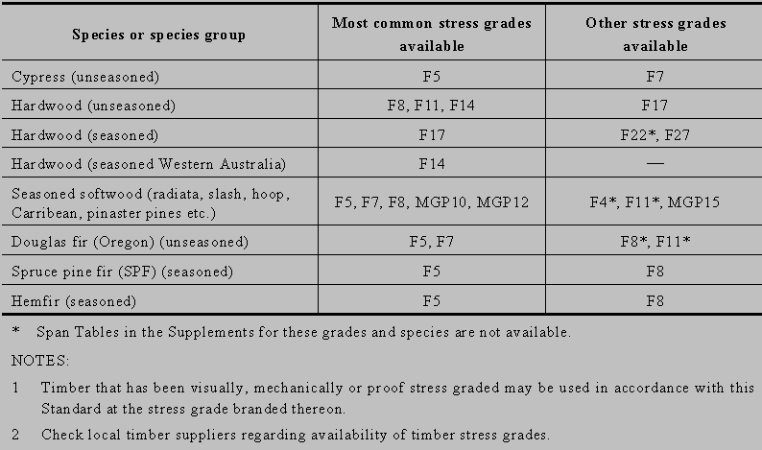
AS 1684 Residential timber-framed construction
Table 1.2
STRESS GRADES

